Slide 1
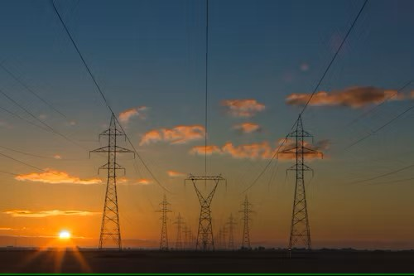
ELECTRIC POWER CONSUMPTION

Slide 2

G.Vamshi Krishna
2203A52127
TRAINER:
Mr.D.Ramesh
Asst.professer

Slide 3
INTRODUCTION
Electricity power consumption is a fundamental and ubiquitous aspect of modern life. It refers to the amount of electrical energy used by various devices, appliances, industries, and infrastructure within a given period. This consumption of electrical energy is a cornerstone of economic development, technological progress, and daily convenience in our contemporary world
Electricity, generated from various sources such as fossil fuels, nuclear, hydroelectric, wind, and solar power, is a versatile form of energy that can be transformed into various useful forms, including lighting, heating, cooling, and mechanical work. As such, it powers everything from our homes, offices, and factories to our transportation systems and communication networks.

Slide 4
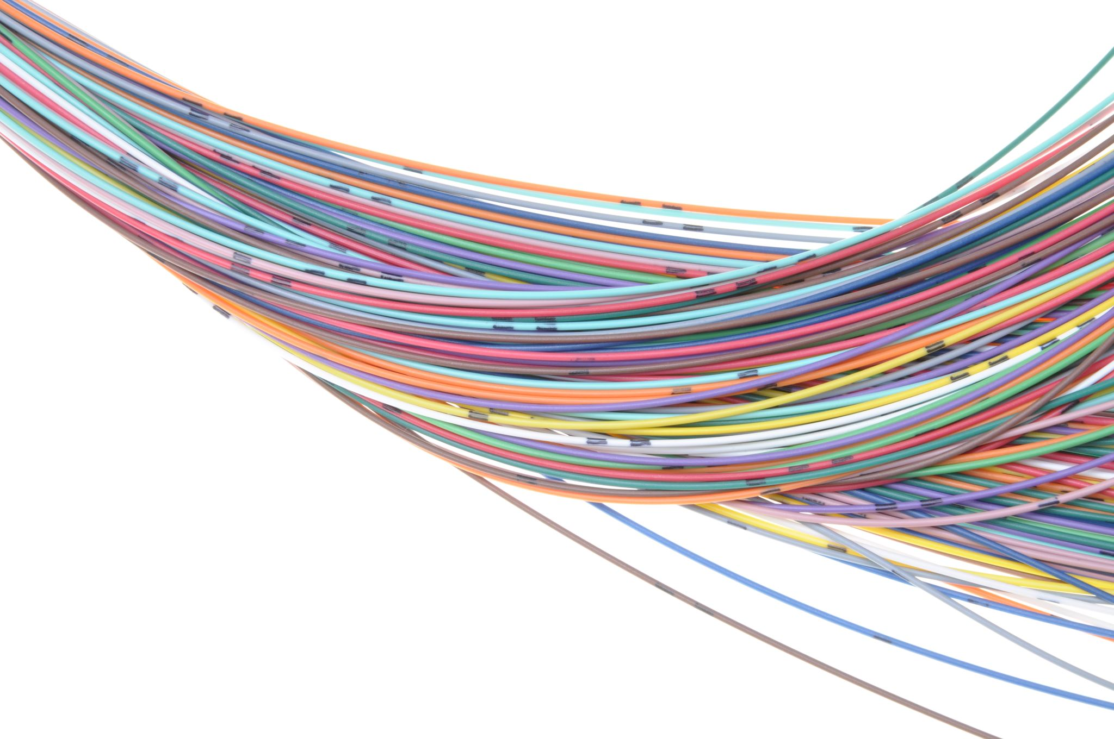
Electricity power consumption is a dynamic field that continues to evolve as we adopt new technologies, embrace renewable energy sources, and seek ways to reduce our carbon footprint. In this context, data analysis, predictive modeling, and the integration of smart technologies play pivotal roles in optimizing and managing our electricity consumption patterns. As we move forward, understanding and responsibly managing electricity power consumption will be integral to achieving a more sustainable, efficient, and technologically advanced future.

Slide 5
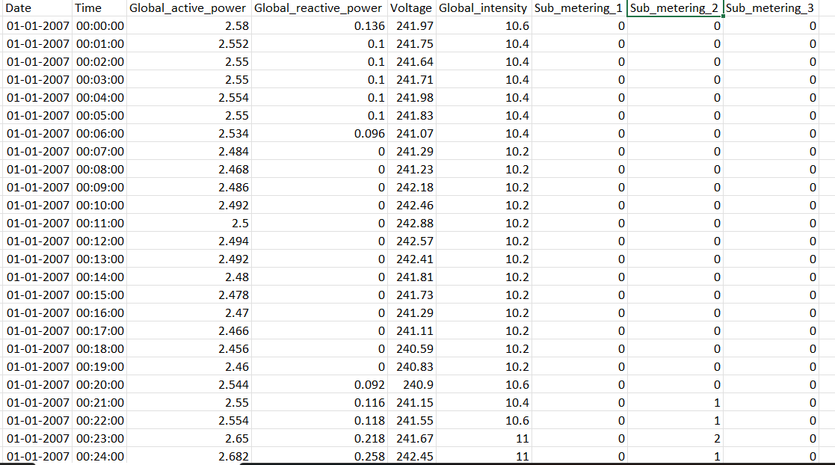
Electric power consumption Data set 260640 instances and 9 Attributes

Slide 6
Attribute Information
1.date: Date in format dd/mm/yyyy
2.time: time in format hh:mm:ss
3.global_active_power: household global minute-averaged active power (in kilowatt)
4.global_reactive_power: household global minute-averaged reactive power (in kilowatt)
5.voltage: minute-averaged voltage (in volt)
6.global_intensity: household global minute-averaged current intensity (in ampere)
7.sub_metering_1: energy sub-metering No. 1 (in watt-hour of active energy). It corresponds to the kitchen, containing mainly a dishwasher, an oven and a microwave (hot plates are not electric but gas powered).
8.sub_metering_2: energy sub-metering No. 2 (in watt-hour of active energy). It corresponds to the laundry room, containing a washing-machine, a tumble-drier, a refrigerator and a light.
9.sub_metering_3: energy sub-metering No. 3 (in watt-hour of active energy). It corresponds to an electric water-heater and an air-conditioner.

Slide 7
Target Variable
The power consumption is chosen as the target variable in our dataset because it represents the net active power consumption, which is a key indicator of electricity usage, and it is formed by calculating the difference between the global active power consumption (in watts per minute) and the total active power consumed by sub-metering components
We can calculate power consumption as follows:
eqn1 = (Global_active_power)*1000/60
eqn2 = Sub_metering_1 + Sub_metering_2 + Sub_metering_3
Now, power consumption = eqn1-eqn2

Slide 8
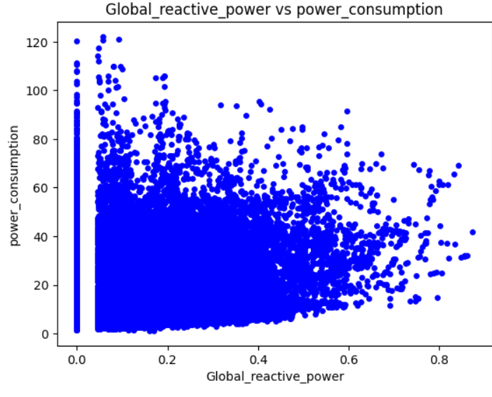
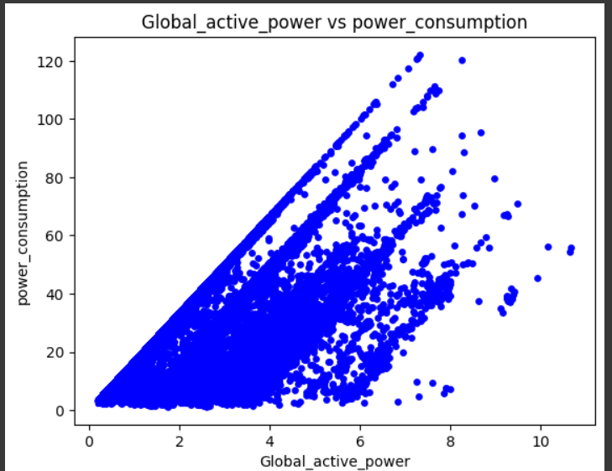
GRAPHS

Slide 9
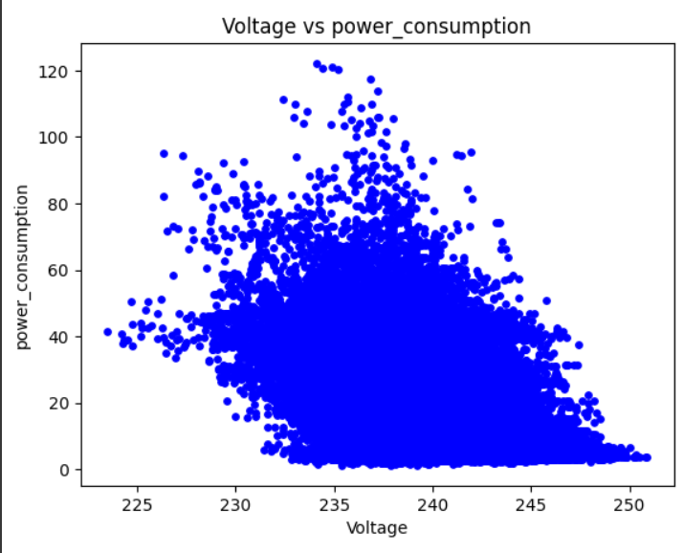
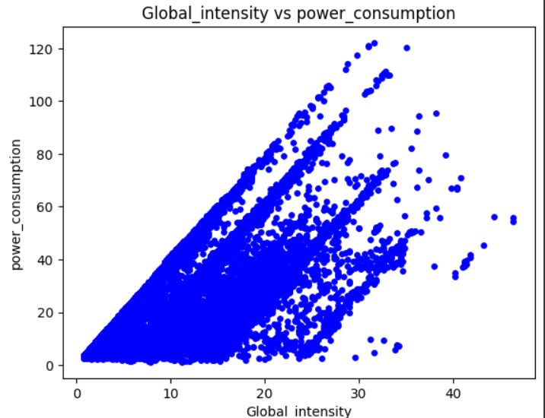
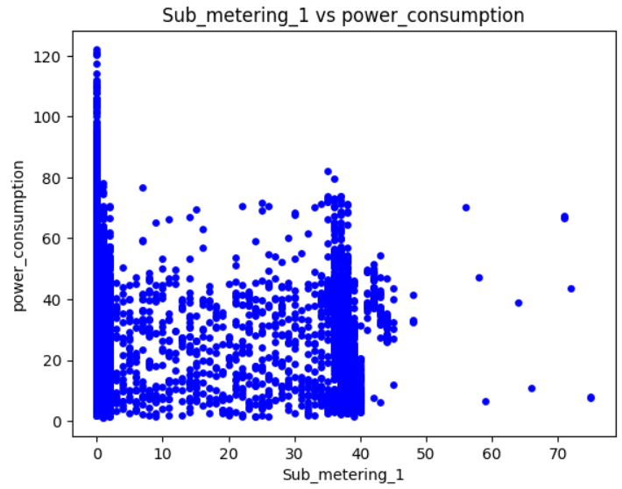

Slide 10
MACHINE LEARNING MODEL
The machine learning models used in this project are:
1)Linear regression
2)Support Vector Machine(SVM)
Machine learning models
Linear regression
Support vector machine

Slide 11
Linear Regression
Linear regression is a fundamental statistical method used in data analysis and machine learning. It models the relationship between a dependent variable (the target) and one or more independent variables (predictors) by fitting a linear equation. The goal is to find the best-fit line that minimizes the difference between predicted and actual values. This technique is widely used for tasks like predicting outcomes, understanding correlations, and estimating trends. It provides insights into how changes in independent variables affect the target. Linear regression is simple yet powerful, serving as a foundation for more complex models and allowing for interpretable, quantitative analysis of relationships in data.
Linear regression is widely used in various fields for tasks like price prediction, trend analysis, and more, but it works best when the relationship between inputs and outputs is approximately linear.

Slide 12
Support Vector Machine
A Support Vector Machine (SVM) is a powerful machine learning model used for classification and regression tasks. It works by finding the optimal hyperplane that best separates different classes of data points, maximizing the margin between them. SVMs are known for their versatility and ability to handle both linear and non-linear datasets through various kernel functions. This model is widely used in applications like image classification, text categorization, and bioinformatics due to its ability to make accurate predictions while minimizing overfitting. SVMs are favored for their robust performance and interpretability, making them a valuable tool in the field of machine learning.

Slide 13
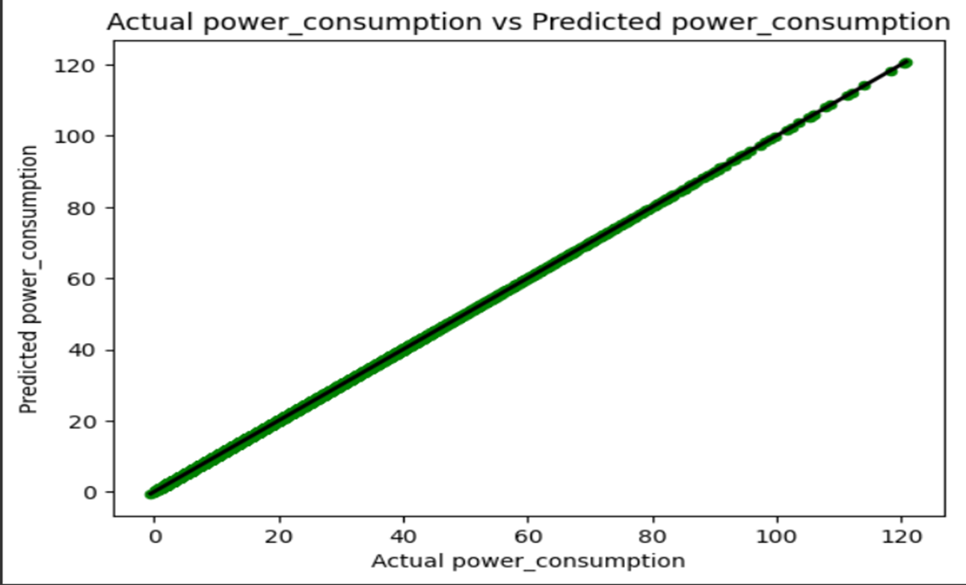
ERROR for linear regression
Mean Squared Error (MSE): 0.00000
Mean Absolute Error (MAE): 0.00000
Root Mean Squared Error (RMSE): 0.00000
Best Fit Line for linear regression

Slide 14
LASSO REGRESSION
Lasso regression, short for "Least Absolute Shrinkage and Selection Operator" regression, is a linear regression technique used for feature selection and regularization in machine learning. It introduces L1 regularization to the standard linear regression cost function, adding a penalty term that encourages some of the coefficients to become exactly zero. This makes Lasso regression not only a predictive tool but also a feature selection method.
The key idea behind Lasso is to reduce the influence of less important features by effectively eliminating them from the model. As the regularization strength, represented by a hyperparameter (λ), increases, more coefficients are shrunk to zero. This can help create simpler and more interpretable models while improving their generalization performance.

Slide 15
RIDGE REGRESSION
Ridge regression is a linear regression technique used in machine learning and statistics to address multicollinearity and overfitting issues in regression models. It adds a regularization term, often represented as L2, to the linear regression's cost function. This regularization term penalizes the magnitude of the coefficients, discouraging them from becoming too large.
In Ridge regression, the objective is to minimize the sum of squared differences between the predicted values and the actual values (the standard linear regression objective) while also keeping the sum of the squared coefficients as small as possible. The regularization term, controlled by a hyperparameter called lambda (λ), balances these objectives. A higher λ value leads to more significant shrinkage of the coefficient values.

Slide 16
KNN REGRESSION
K-Nearest Neighbors (KNN) regression is a machine learning algorithm used for predicting continuous values, making it suitable for regression tasks. KNN works on the principle of similarity: it predicts the value of a new data point by considering the K nearest data points (neighbors) in the training dataset. In regression, these neighbors' target values are averaged to make the prediction.
Here's how KNN regression works:
1. Choose the number of neighbors (K) to consider.
2. Calculate the distances between the new data point and all data points in the training set, often using methods like Euclidean distance.
3. Select the K nearest neighbors.
4. Average their target values to predict the value for the new data point.

Slide 17
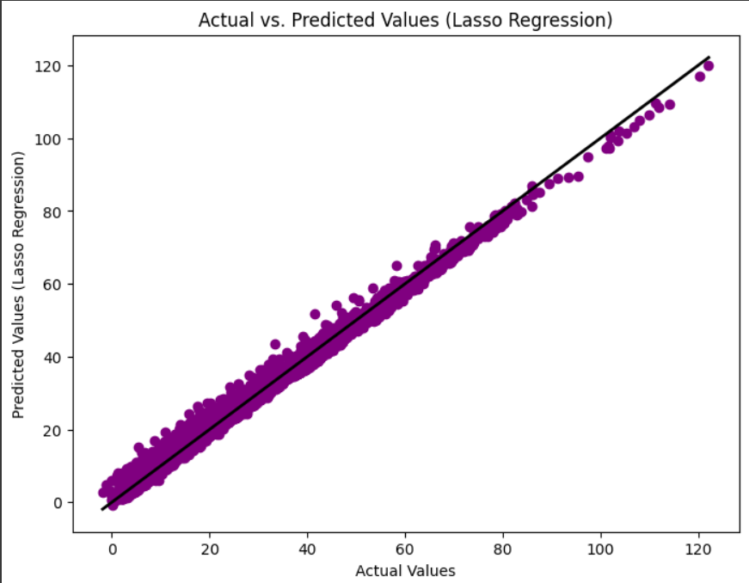
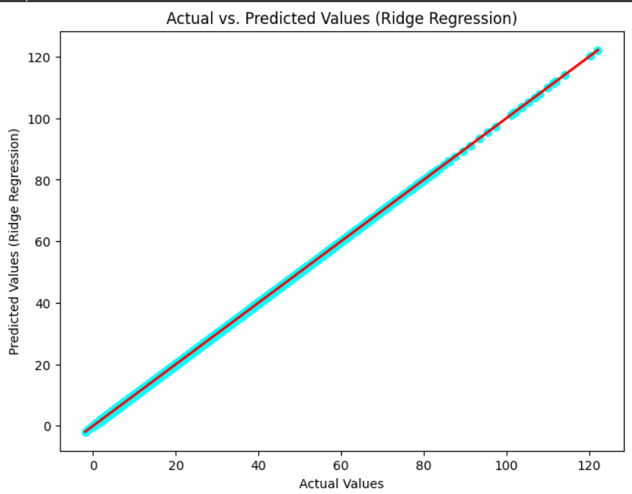

Slide 18
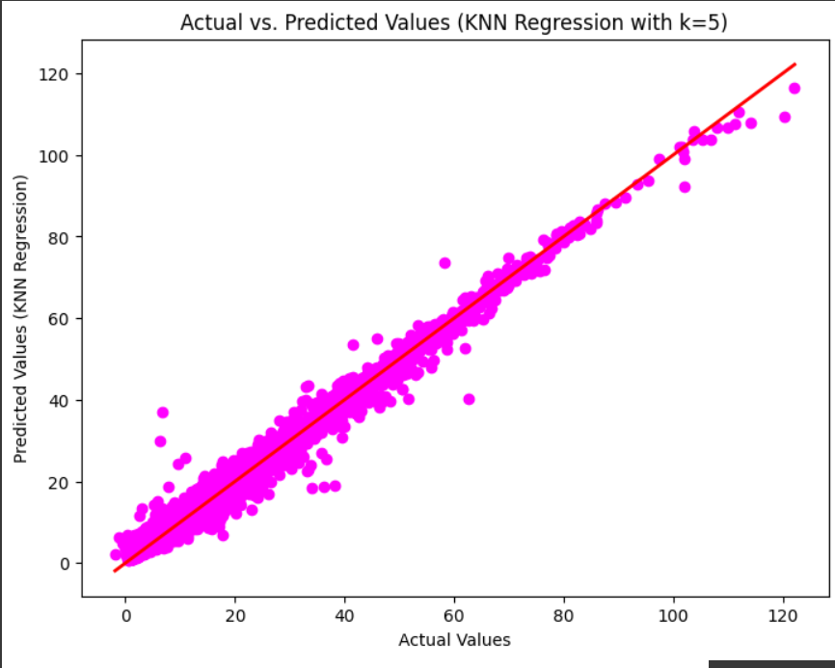

Slide 19
CONCLUSION
In conclusion, electric power consumption is a crucial domain for machine learning applications. By harnessing data-driven insights and predictive modeling, we can optimize energy usage, reduce costs, and contribute to sustainability efforts. Machine learning enables us to understand complex consumption patterns, forecast future demands, and identify anomalies efficiently. With the increasing availability of smart meters and IoT devices, the potential for precise analysis and real-time management of electricity consumption is vast. Embracing machine learning in this field empowers us to make informed decisions, drive innovation, and pave the way for a more efficient and environmentally conscious energy landscape.

Slide 20


